Slide 1
Growing Outstanding Digital Citizens

Slide 2
Ryan Torbey
K-5 Technology Teacher
Harmony School of Science - Austin
Follow me @RyanTorbey

Slide 3
The world has changed.

Slide 7
We need to cultivate outstanding digital citizens.
Direct Instruction
Authentic Practice
Strong Digital Citizen

Slide 8
“The student practices safe, responsible, legal, and ethical behavior while using digital tools and resources.” – TEKS

Slide 9
So… you want to grow outstanding digital citizens?
Direct Instruction

Slide 10
Goals for Direct Instruction
Awareness
Empathy
Insight

Slide 11
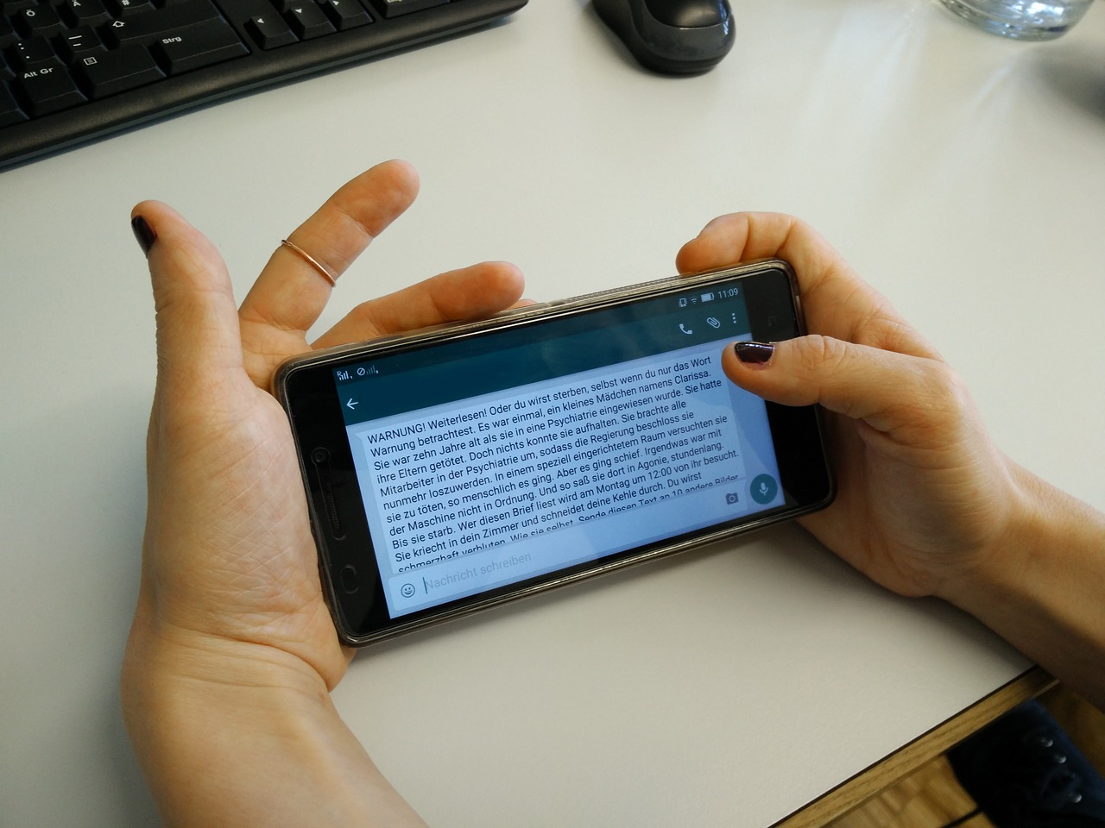
Awareness

Slide 12
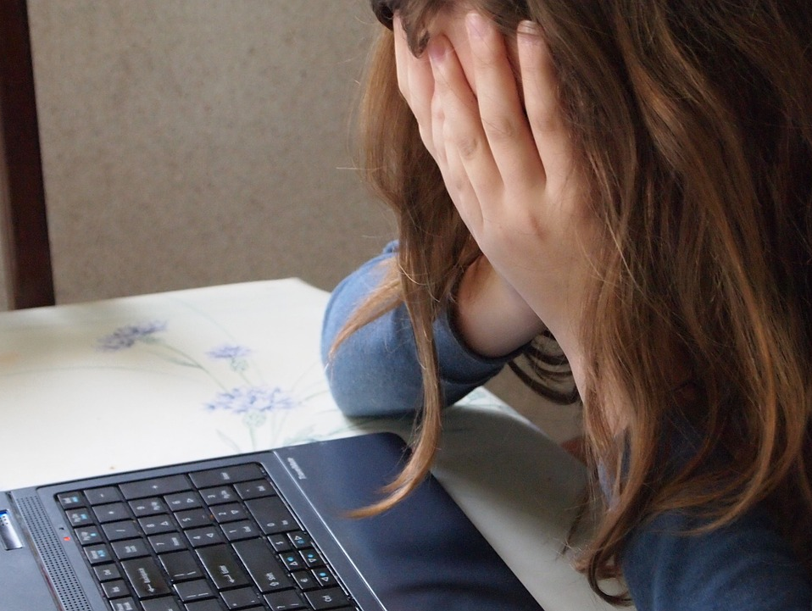
Empathy

Slide 13
Insight

Slide 14
5 (A) adhere to acceptable use policies reflecting positive social behavior in the digital environment;
5 (D) protect and honor the individual privacy of oneself and others;
5 (E) follow the rules of digital etiquette;
TEKS

Slide 15
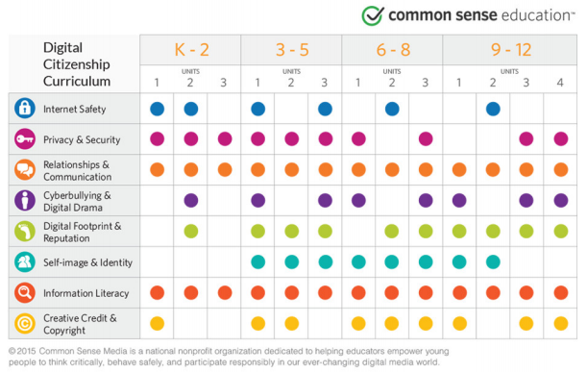

Slide 16
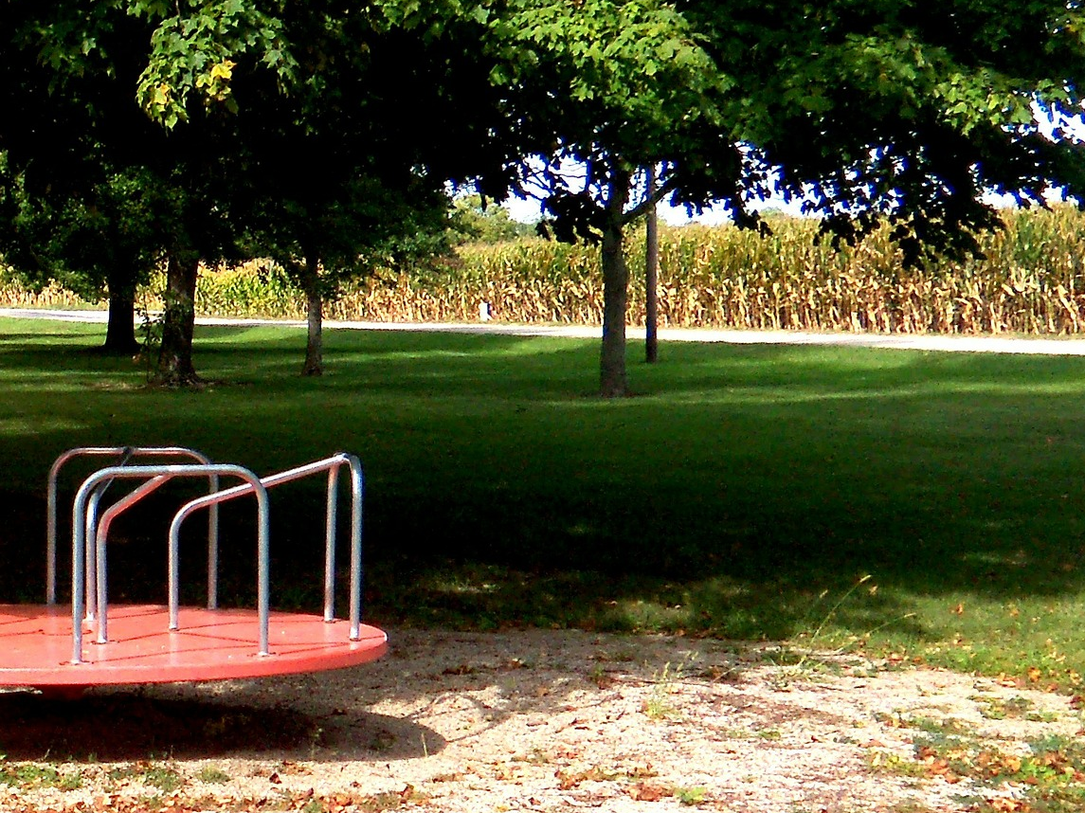
You are playing tag with your classmates at recess. You’re nervous because one of your classmates has been picking on you and treating you meanly. That classmate pushes you down and says, “Tag, you’re it!”
You are hurt, but none of your friends stops to help.

Slide 19
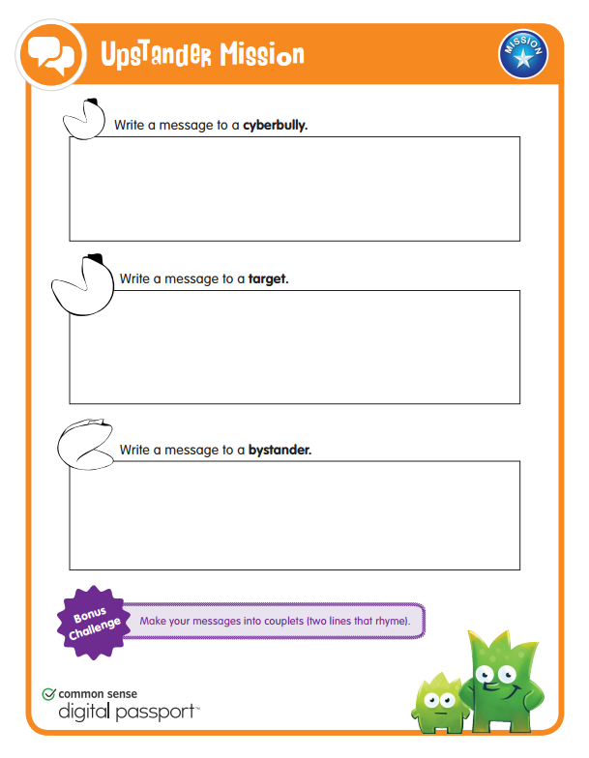

Slide 20
How would you describe cyberbullying to someone
who didn’t know the term?
If you are being bullied, what should you do?
What are some ways in which you can be an Upstander?

Slide 21
So… you want to grow outstanding digital citizens?
Authentic Practice

Slide 22
Goals for Authentic Practice
Practice
Practice
Practice

Slide 23
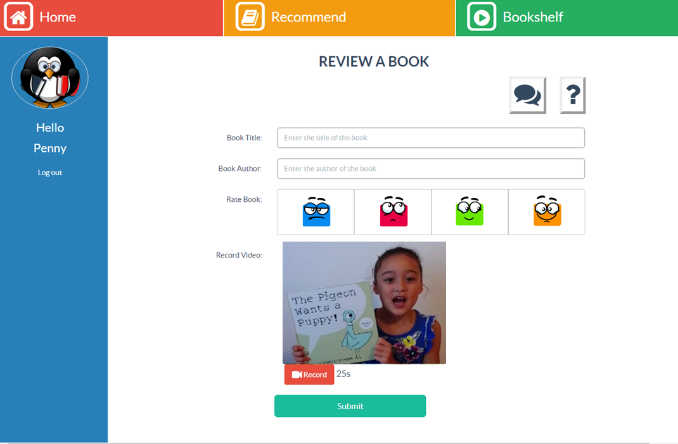
BookAround

Slide 24
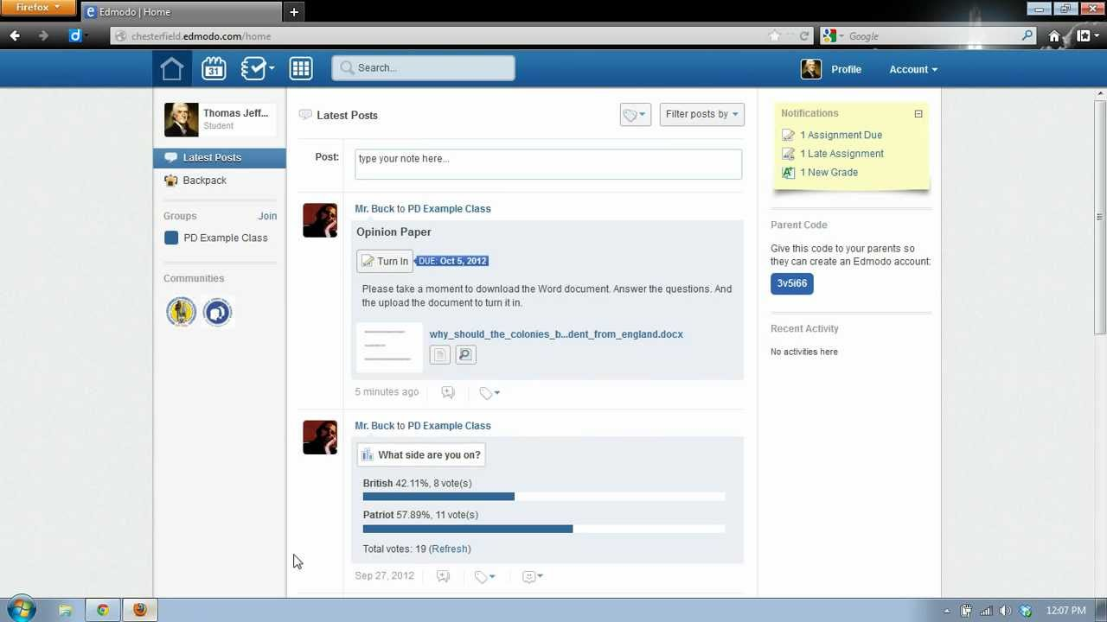
Edmodo

Slide 25
Digital Storytelling

Slide 26
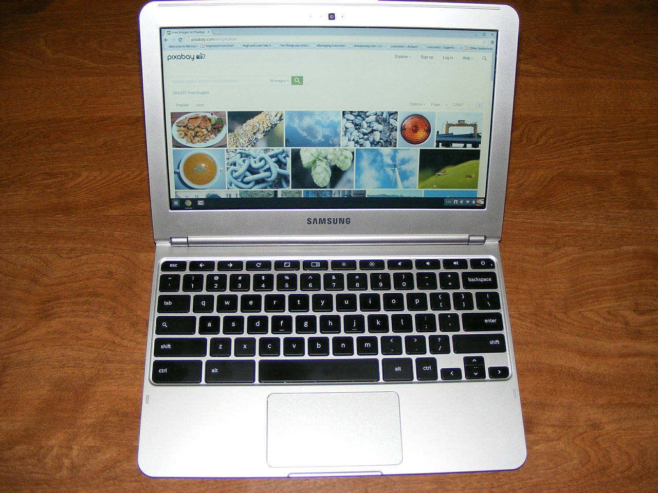
All Day, Every Day

Slide 27
Digital Citizenship
Digital Leadership

Slide 28
Learn and Share Learning
Advocate
Start Conversations
Take Action
Drive Change
Empower Others with no Voice
Address Societal Inequity
Join Together as Partners
Positively Influence the Lives of Others

Slide 29
Growing Outstanding Digital Citizens

